Slide 1
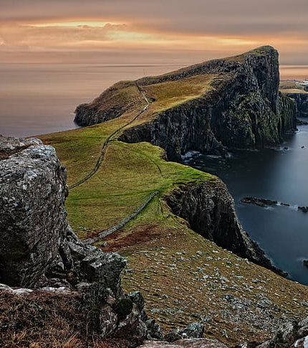
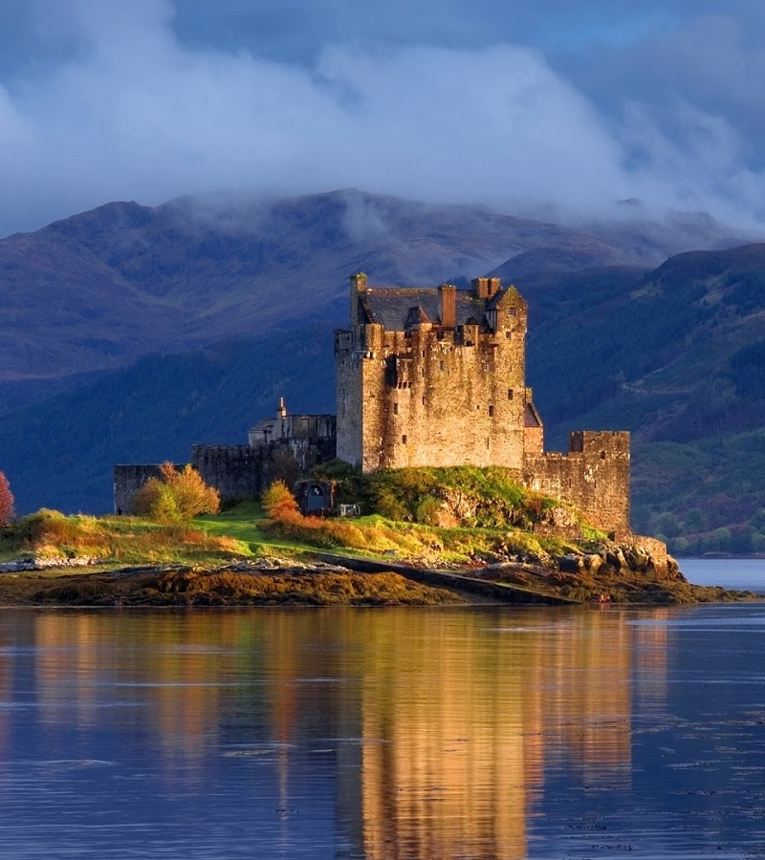
Scotland
- a country of the United Kingdom
This Photo by Unknown author is licensed under CC BY.

Slide 2
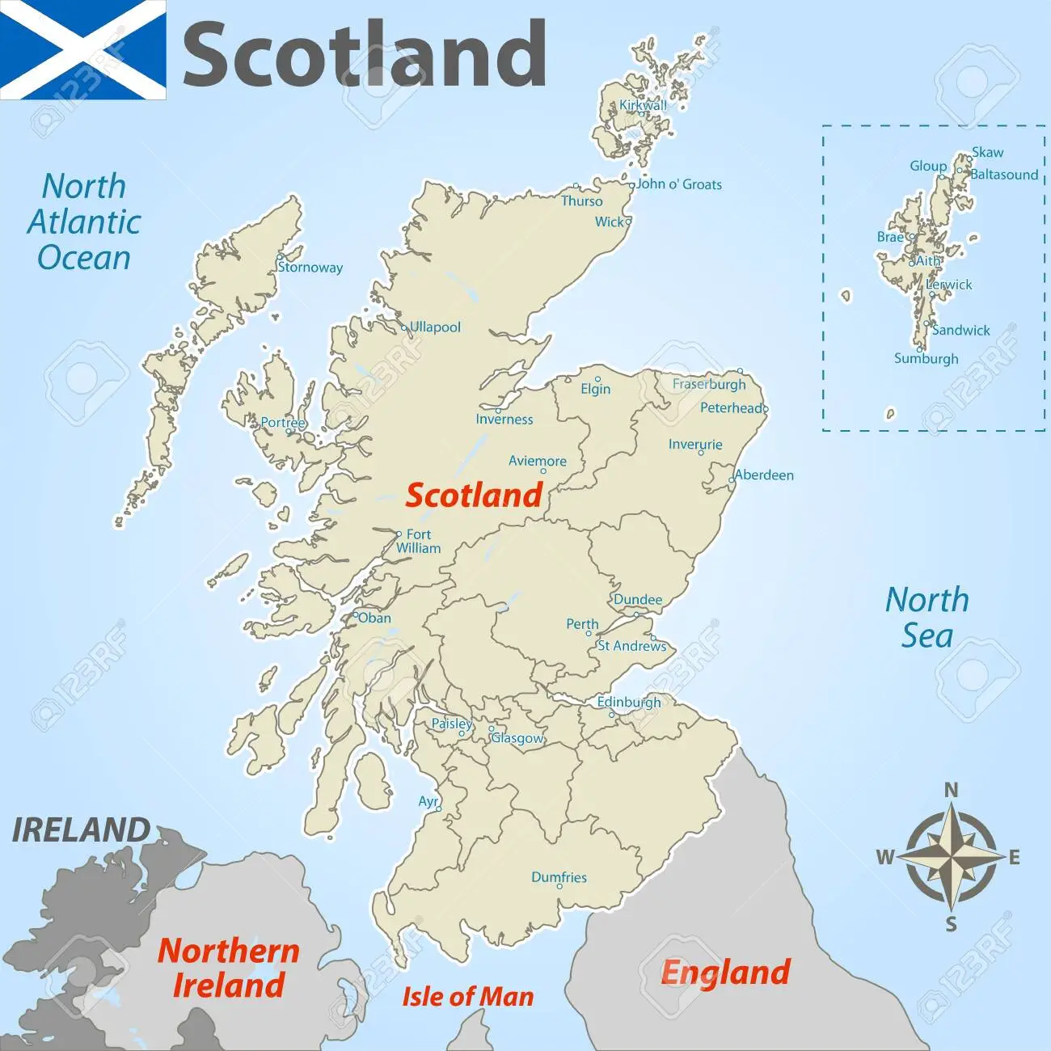
GEOGRAPHY OF SCOTLAND
Scotland is located in the Northwest part of Europe, in the Northern half of the island of Great Britain.
It is one of the four countries that form the United Kingdom. (England, Scotland, Wales and Northern Ireland.)
Its population is about 5,254,800 inhabitants.
The size of the land of Scotland is 78,772 square kilometres.
Scotland has coasts on the North Sea to the East, the Atlantic Ocean to the West and the Irish Sea to the Southeast.
Its only land border is with England in the South.

Slide 3
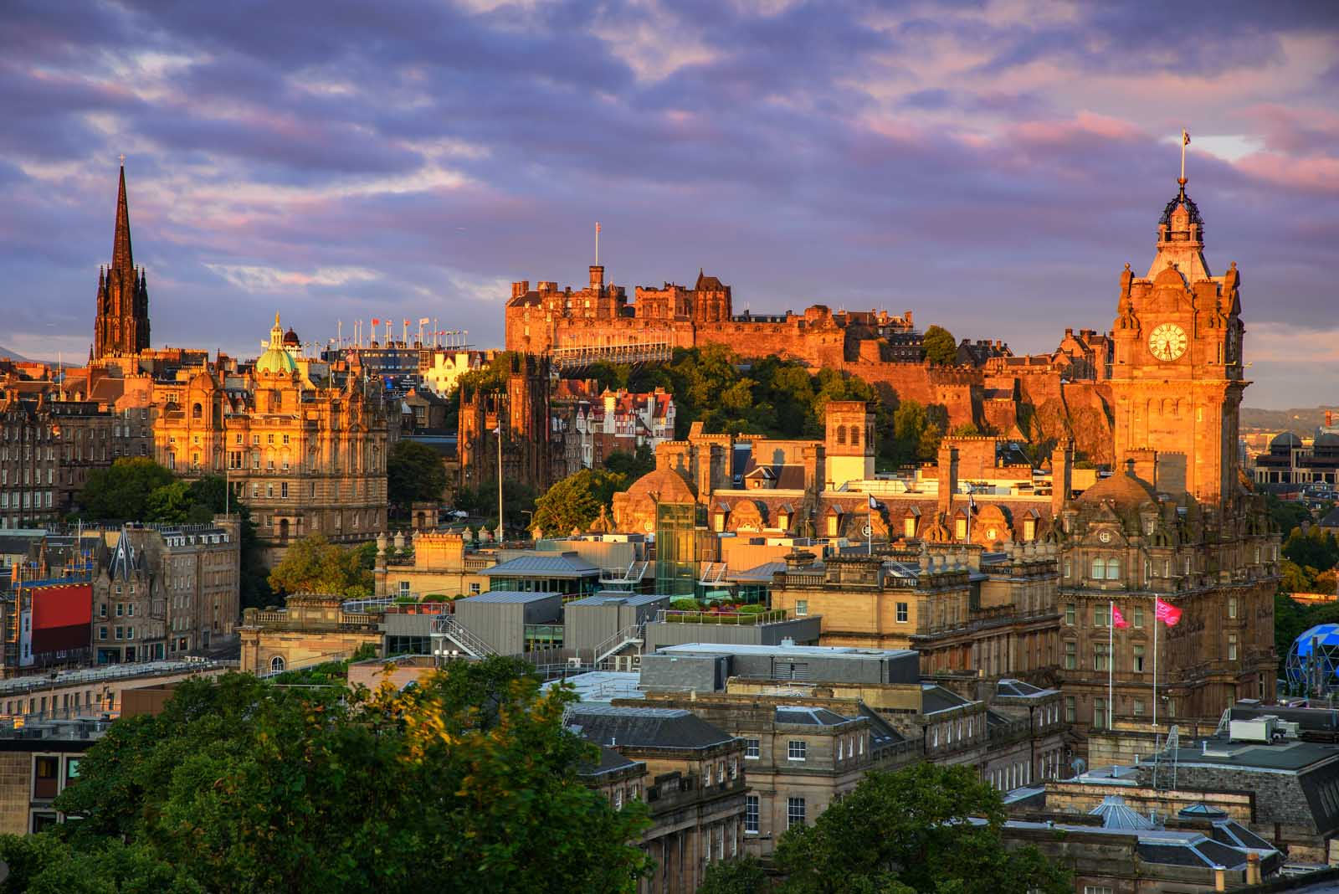
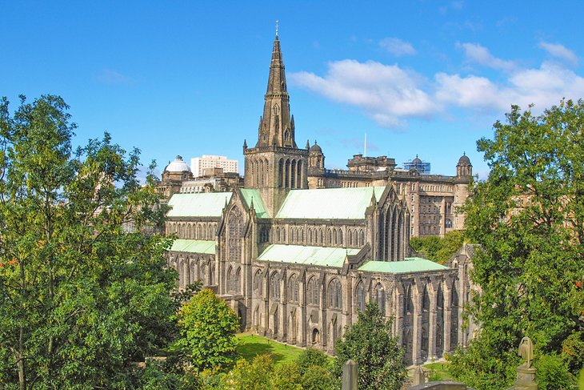
The capital is Edinburgh, but the largest city is Glasgow.

Slide 4
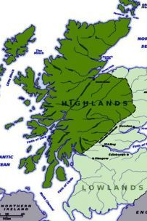
Two Geographic Regions
The Highlands, in the north, are occupied by a series of lakes and the Grampian Mountains.
The Lowlands, which include some of Scotland’s best farmland, comprise the other two major regions: the Midland Valley (Central Lowlands) and the Southern Uplands

Slide 5

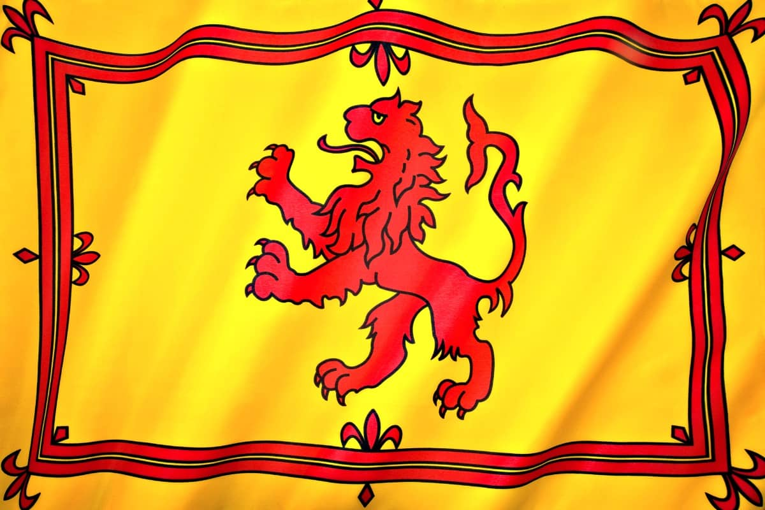
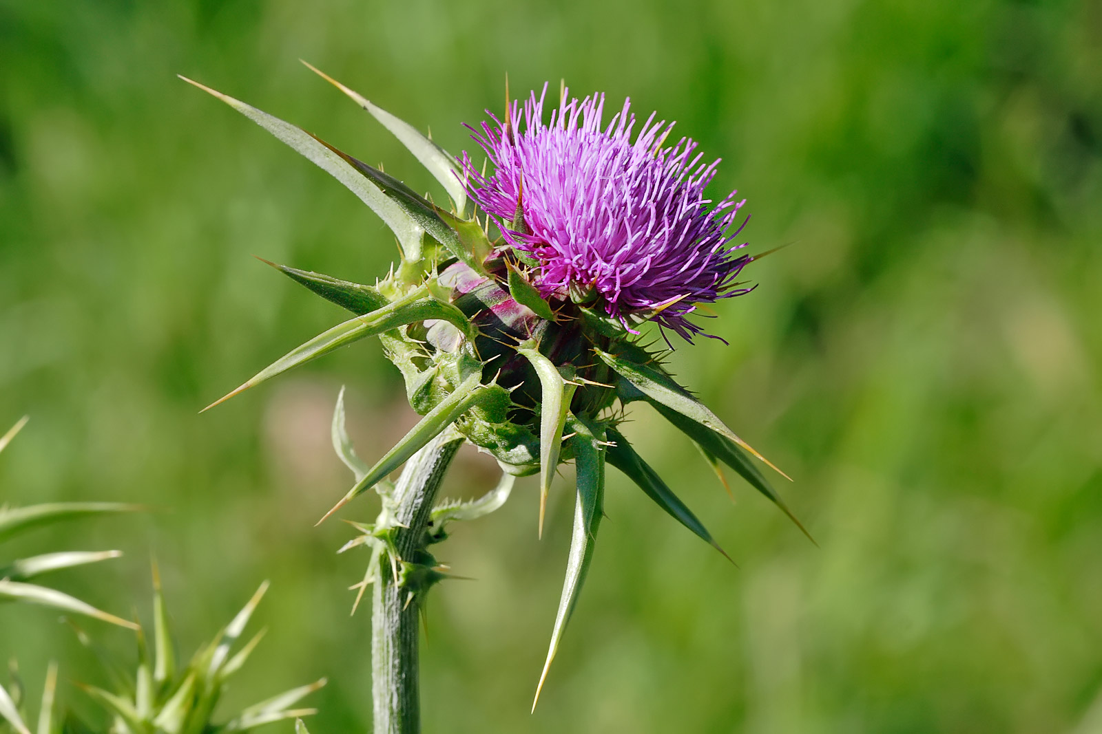
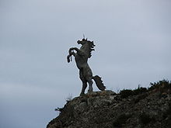
The Flag of Scotland is blue with a white diagonal cross . This is the cross of Saint Andrew, who is the patron saint of Scotland.
An image of a red lion "rampant" is the traditional coat of arms of the Scots monarchy.
Other symbols used for Scotland are the thistle and the unicorn.

Slide 6
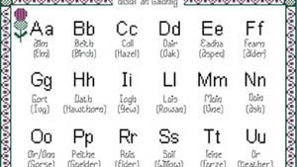
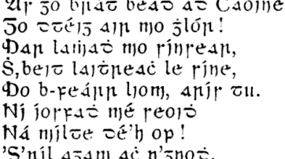
LANGUAGES
The official languages of Scotland are English, Scots and Scottish Gaelic
The dialect of English spoken by Scotland is referred to as Scottish English Scots alphabet
The population is a blend of Celtic, Angle, and Norman ancestry.
Scottish Gaelic orthography

Slide 7
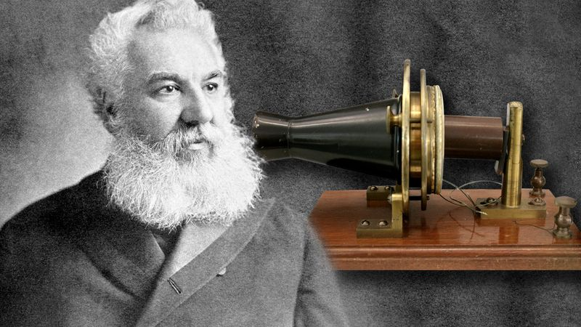
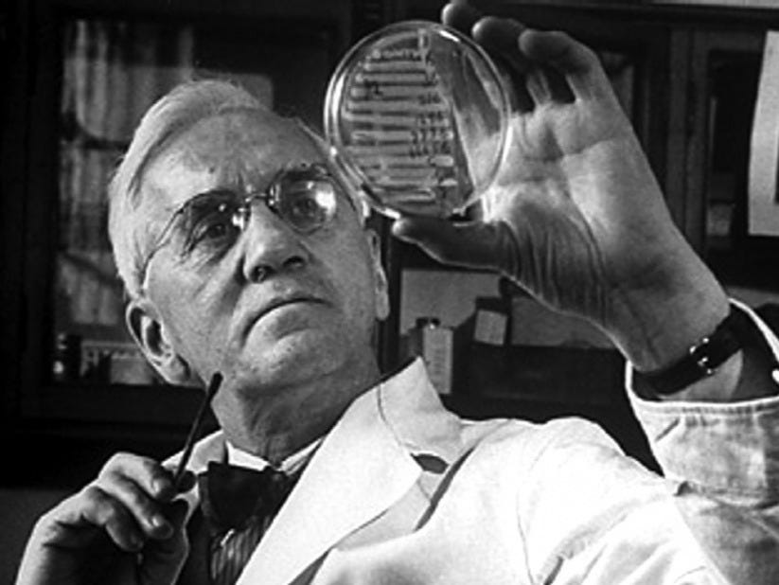
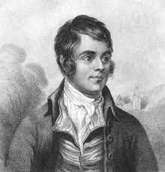
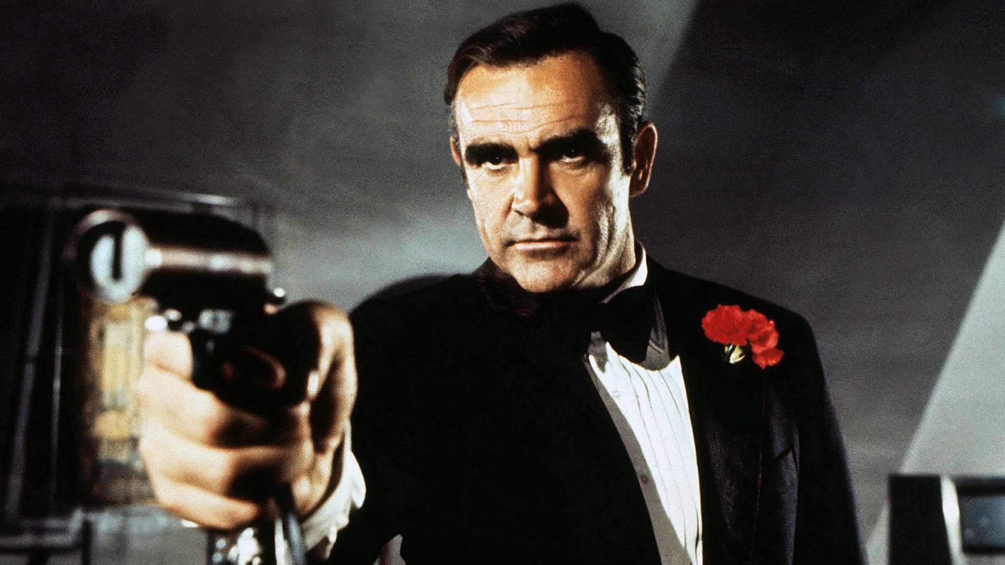
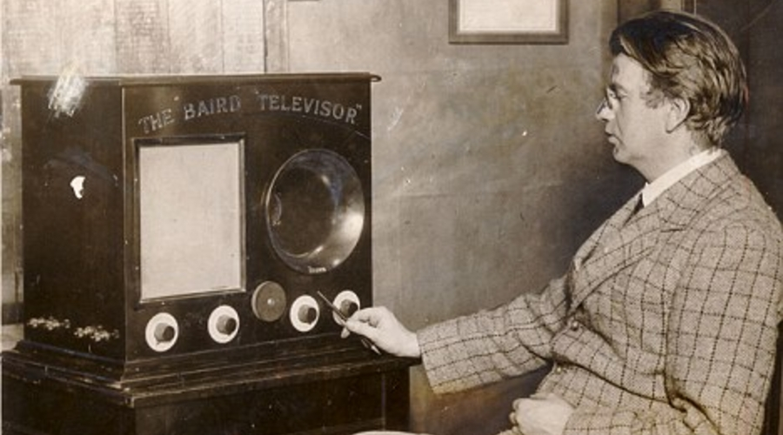
SOME OF SCOTLAND'S IMPORTANT PEOPLE
Alexander Graham Bell (1847 – 1922)
Inventor of the telephone
Alexander Fleming
(1881 – 1955)
Discovered penicillin
Robert Burns (1759 - 1796)
National Poet of Scotland
Sean Connery (1930 - 2020)
Actor and producer - James Bond
John Logie Baird (1888 – 1946)
The world's first live working television system

Slide 8
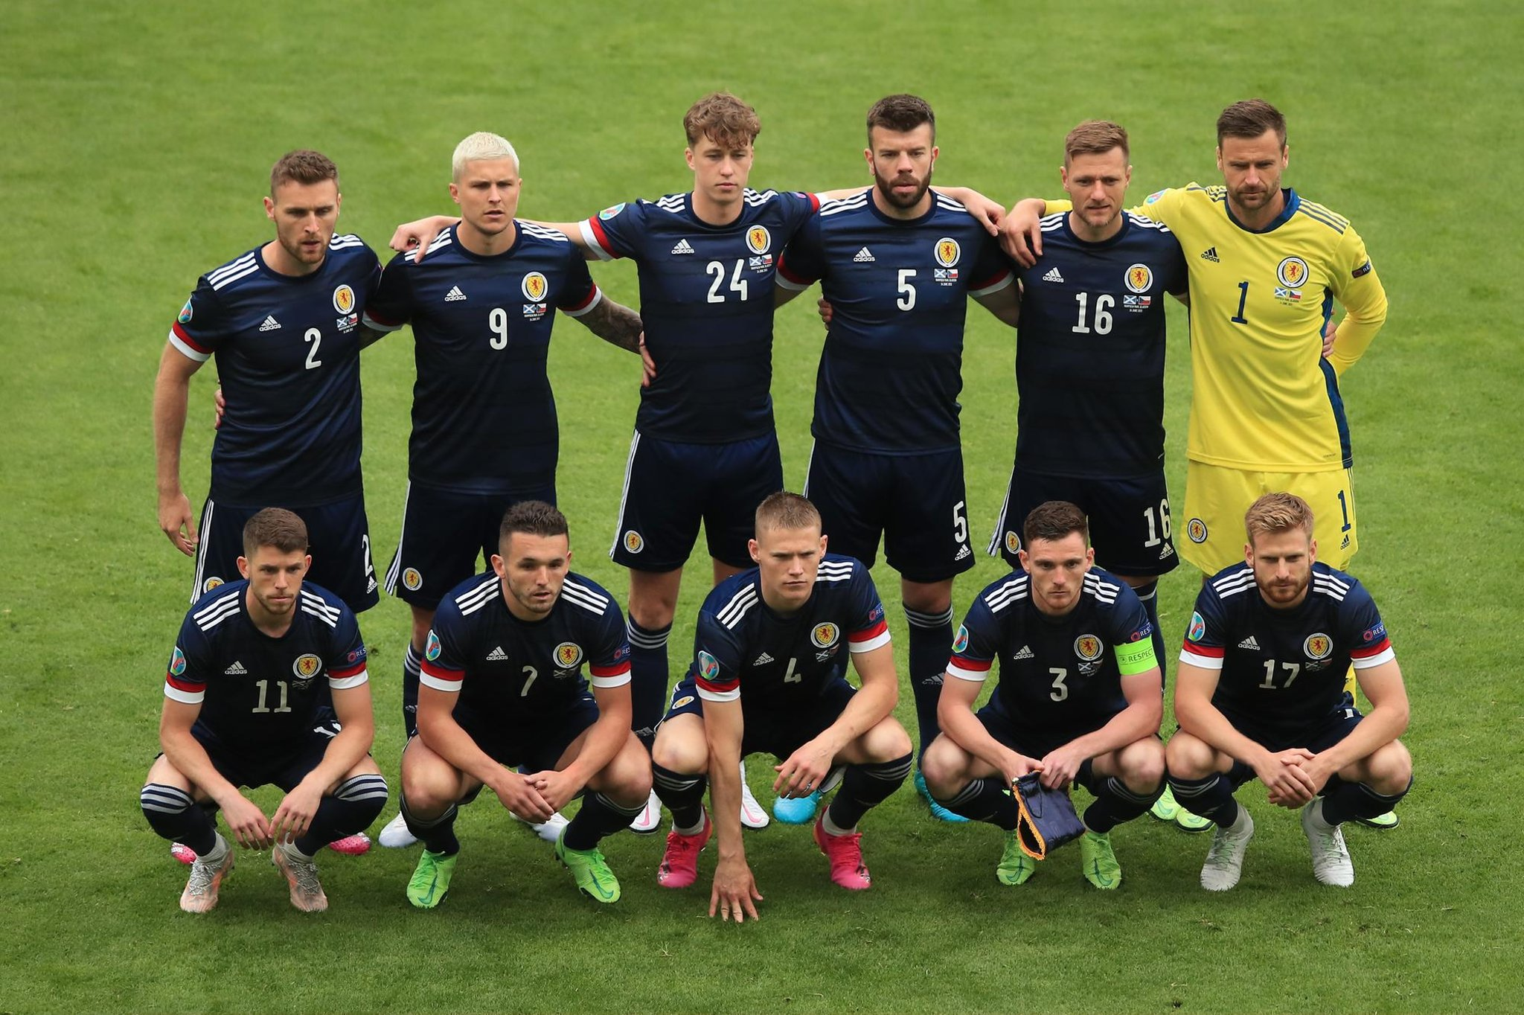
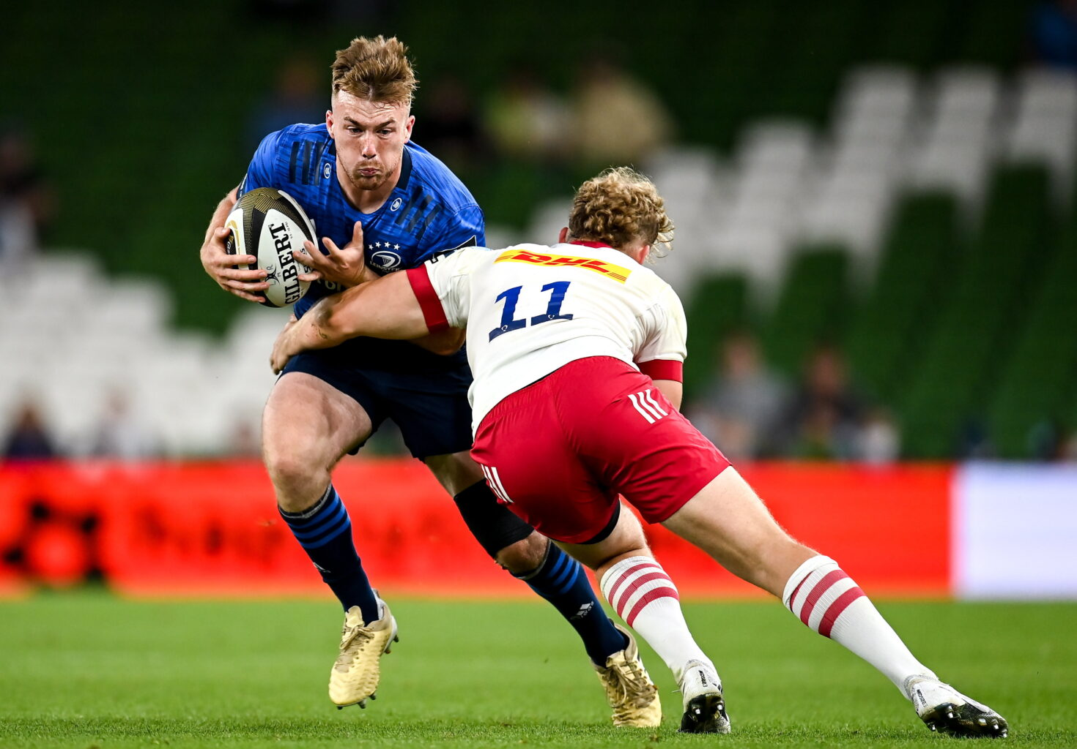
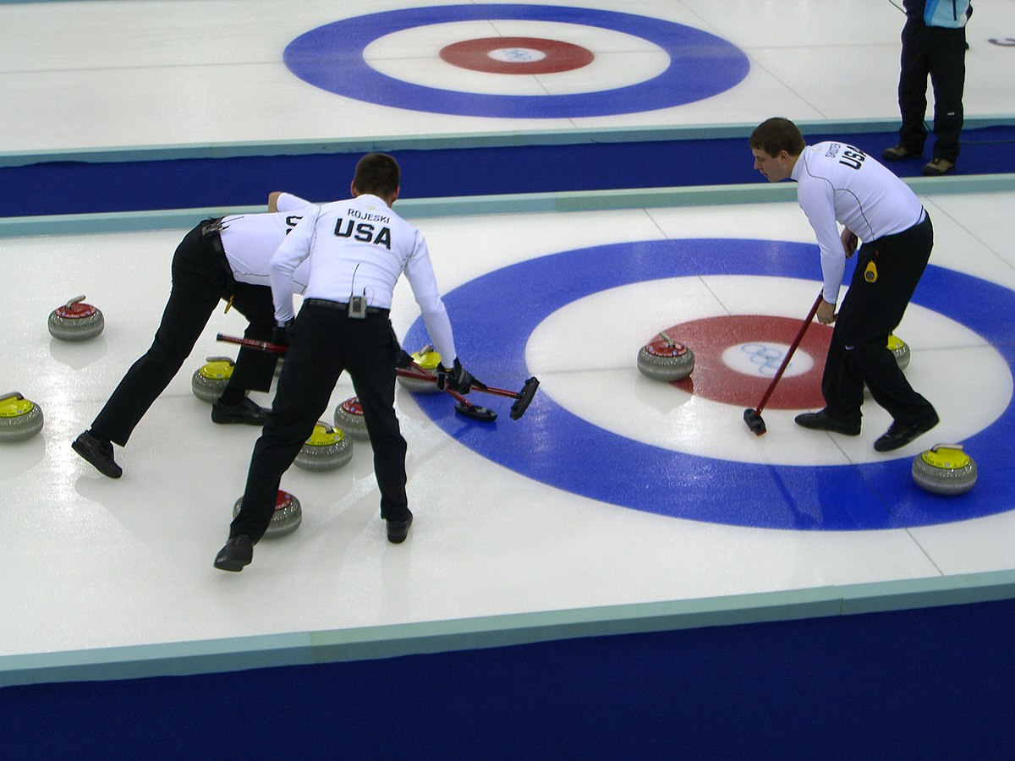
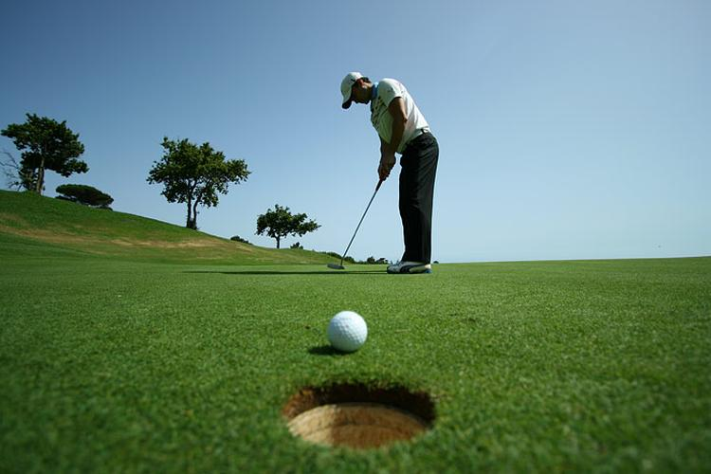
SPORTS
The most popular sports in Scotland are football, rugby, curling and golf

Slide 9
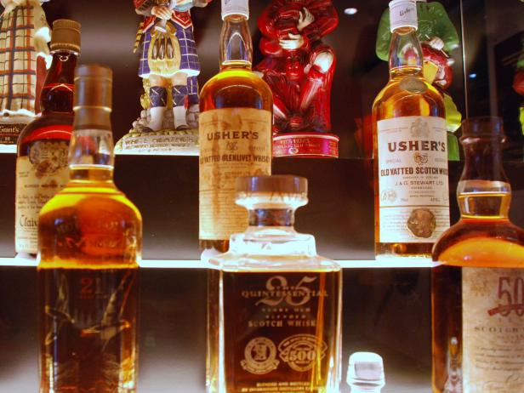
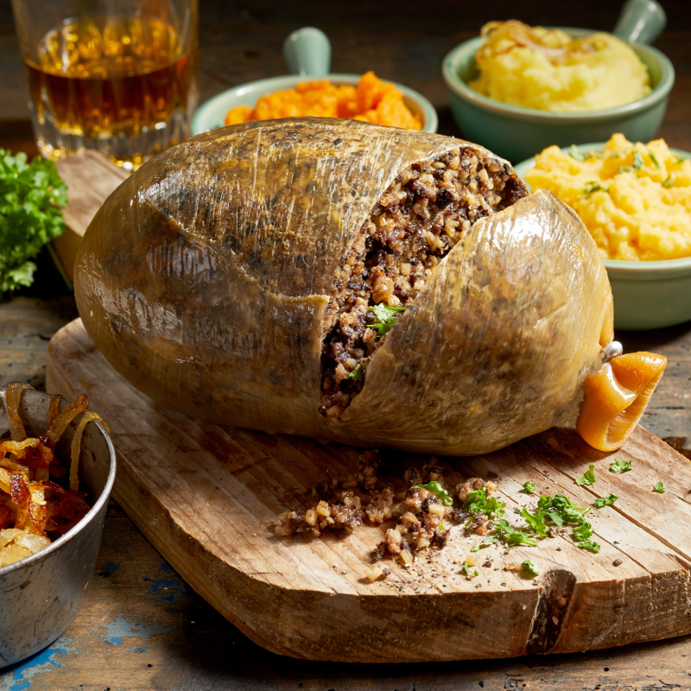
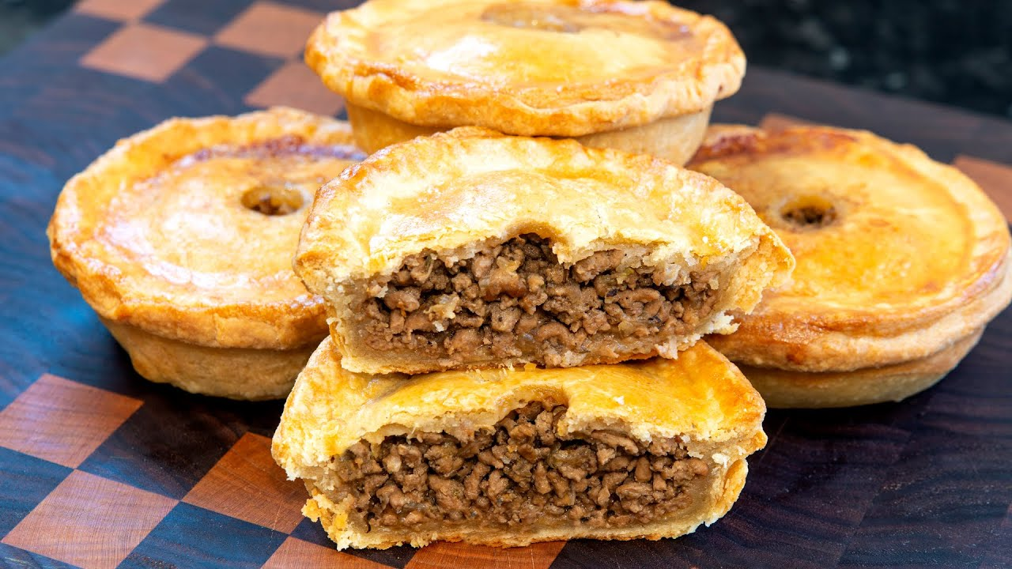
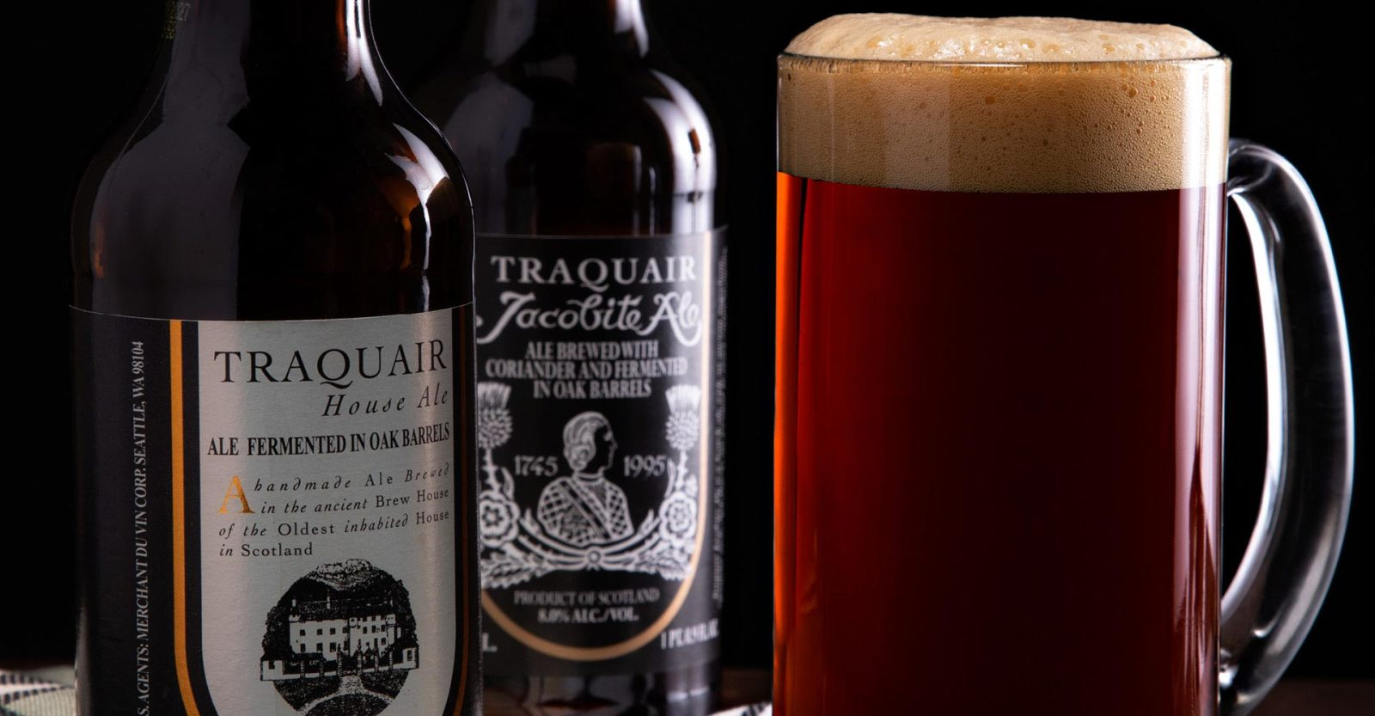
MOST FAMOUS SCOTTISH MEALS AND DRINKS
Scotch is malt whisky or grain whisky
Haggis is a savoury pudding containing sheep's pluck encased in the animal's stomach
Scottish beer made out of bittering herbs
Scotch pie is a small pie filled with meat

Slide 10
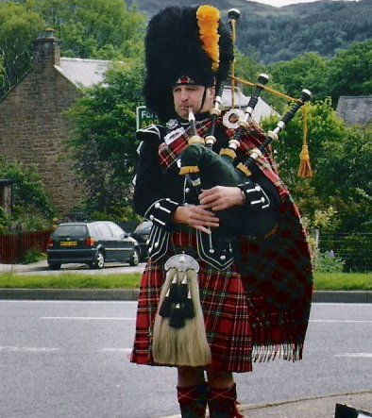
TRADITIONAL MUSIC
Traditional Scottish musical instruments include: the bagpipe, accordion, the fiddle, the harp and tin whistle
Bagpipe – it is a Scottish instrument. Bagpiper blows into tube for air to come into the bag and then the sound comes out of the pipe
Kilts – traditional Scottish woolen a knee-length skirt with a tartan or plaid pattern. It is a skirt that man wear

Slide 11
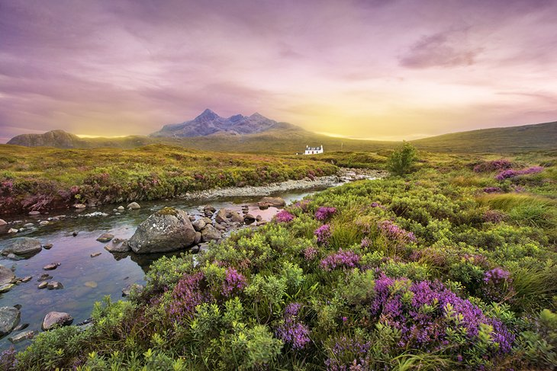
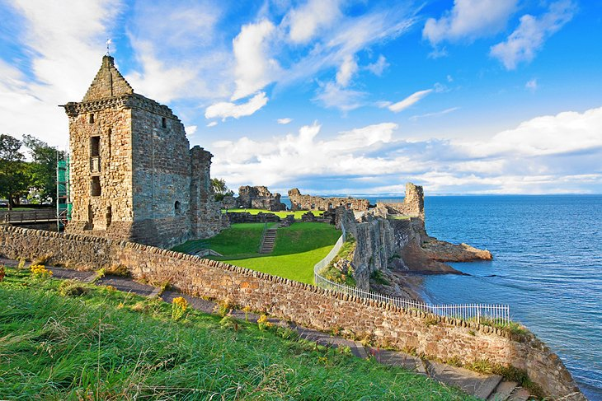
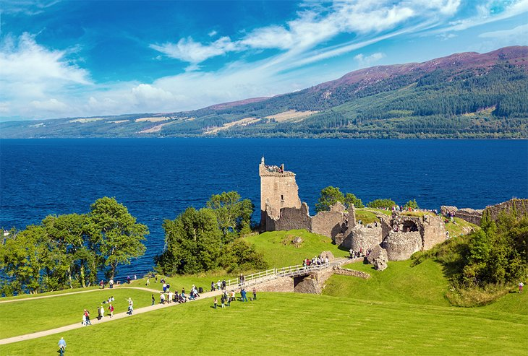
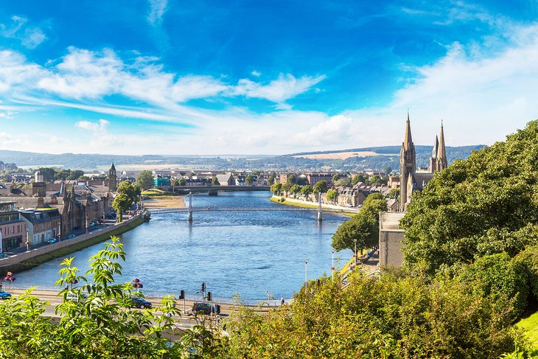
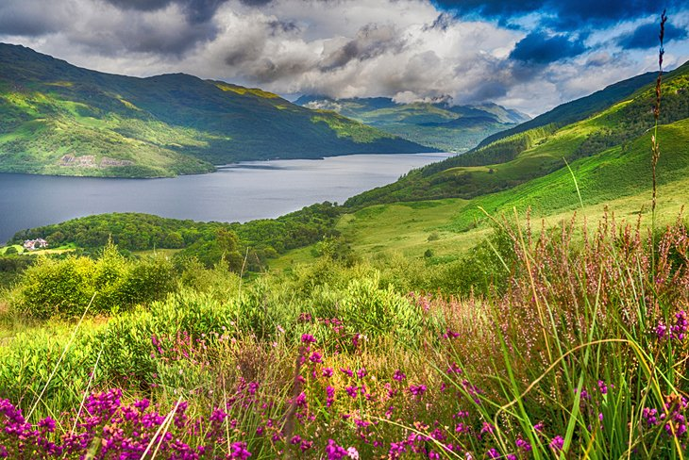
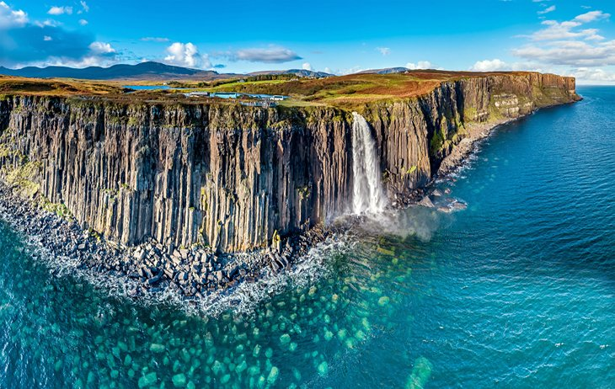
BEAUTIFUL PLACES TO VISIT
Scottish Highlands
St. Andrews
Loch Ness
Nessie
Inverness
Loch Lomond
Isle of Skye

Slide 12
THE END!
Domonji Ana
SR 46/2021

